Slide 1
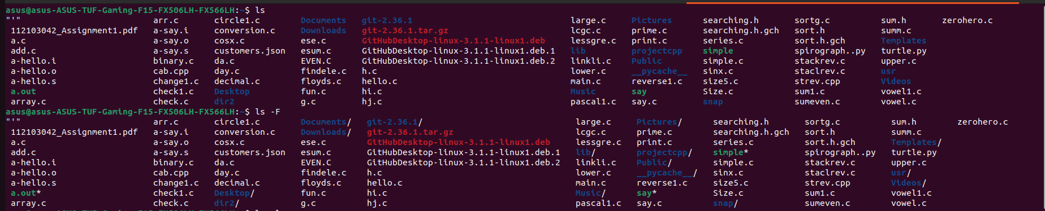
NAME-SHREEYA C GANJI
MIS -112103042
DTL COMMAND EXECUTION ASSIGNMENT
1]
2] ls -a shows hidden files or directories
3] ls *[0-9]* shows files or directories containing numbers
ls- views files and directories

Slide 2
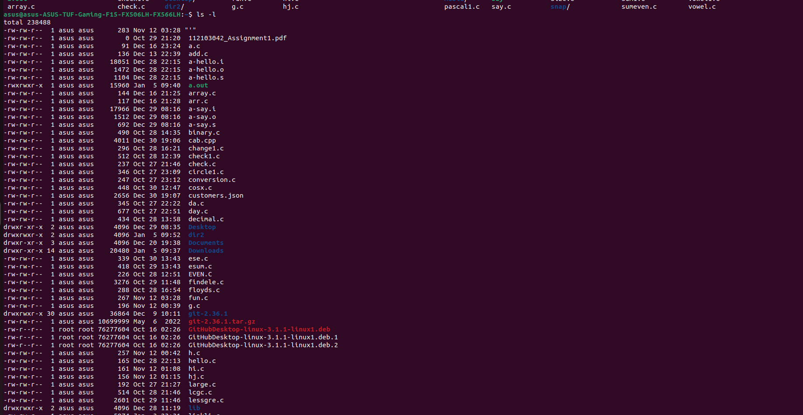

Slide 3
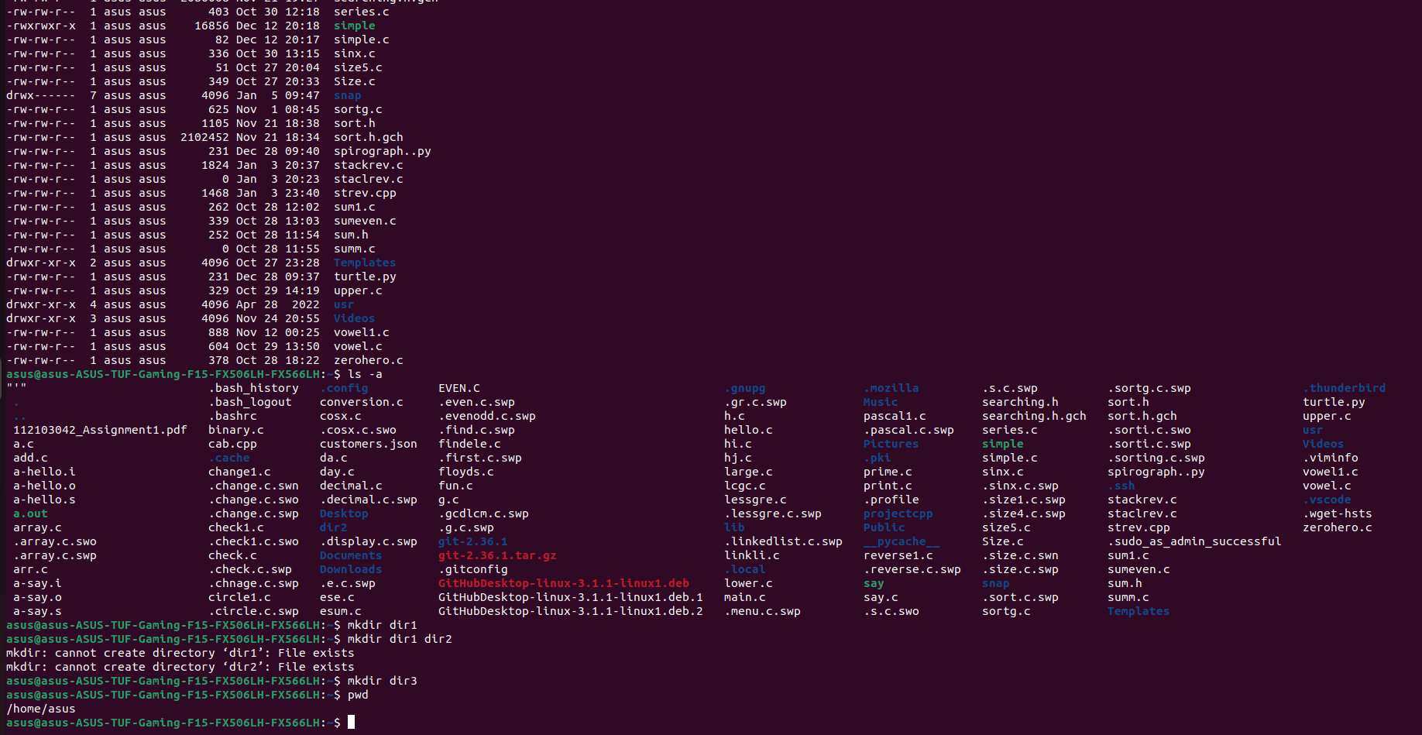

Slide 4
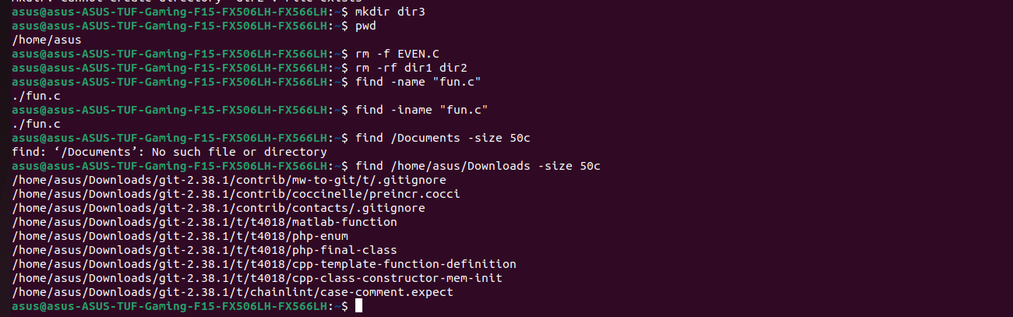
4] mkdir dir1 = create a directory called dir1
5] mkdir -p / tmp /dir1 /dir2 = create a directory tree
6]mv dir/ file/ new_path = move a file or directory
7]pwd = show a path of work directory
8]rm -f file1 = delete a file called “file1”

Slide 5
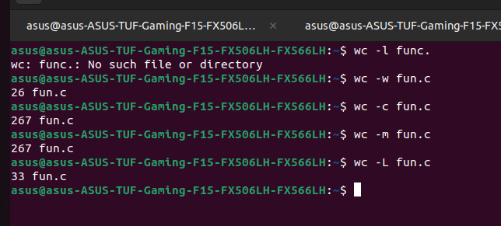
-------------------LINUX COMMANDS TO CHECK WORD COUNT--------------------------
wc -l file_name = print number of lines in file
wc -w file_name =print the number of words in file
wc -c file_name = print the count of bytes in file
wc -m file_name = print the number of characters from a file

Slide 6
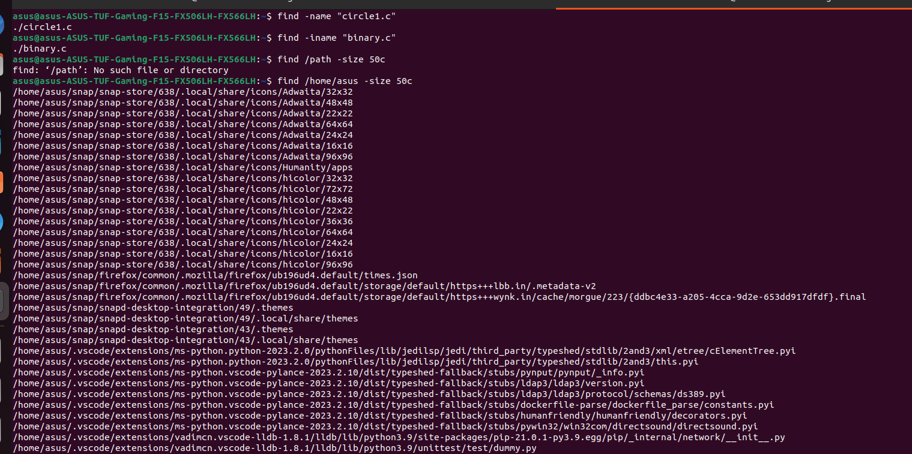
HOW TO USE FIND COMMAND
HOW TO USE FIND COMMAND

Slide 7
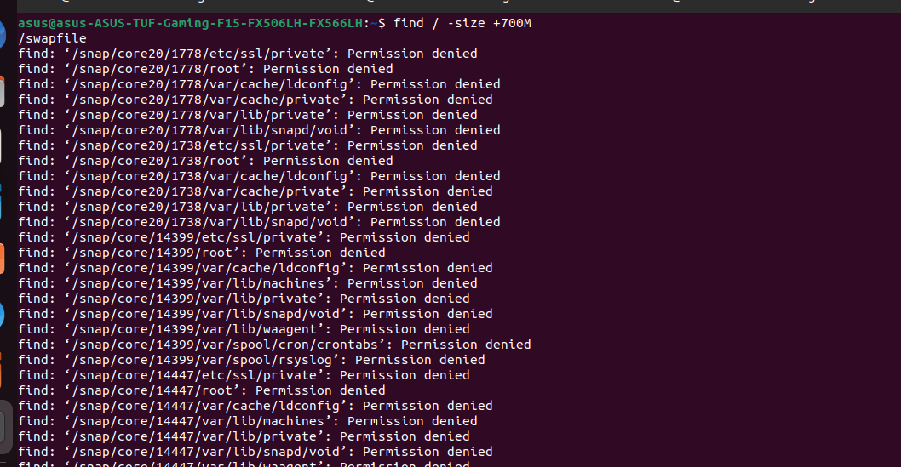

Slide 8
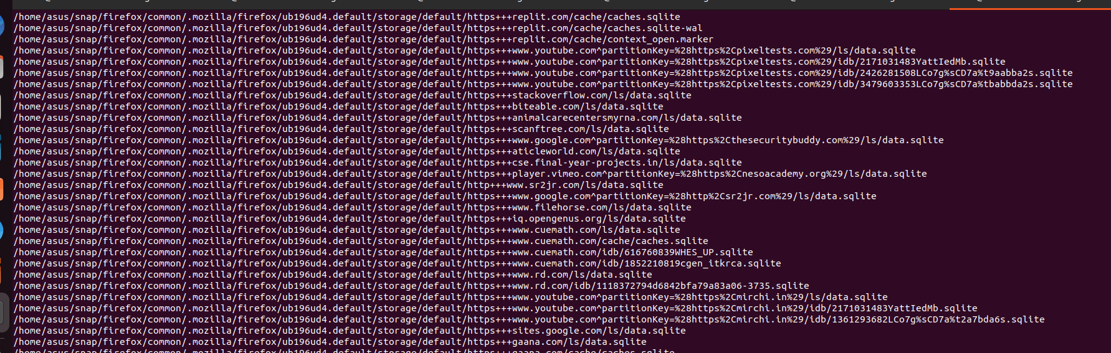

Slide 9
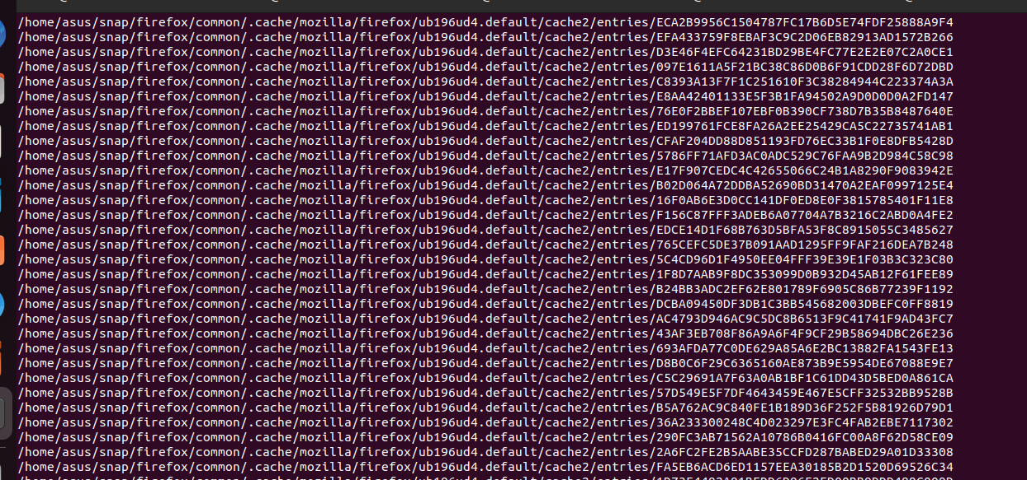

Slide 10
